Slide 1
English
Unit 2 – Sport
WALT:
6Ld.01 - Understand a range of instructions.

Slide 2



WALT: Understand a range of instructions.
With support, I can follow the warm-up instructions.
Independently, I can follow the warm up instructions.
I can suggest exercises to add to a warm up regime.

Slide 3
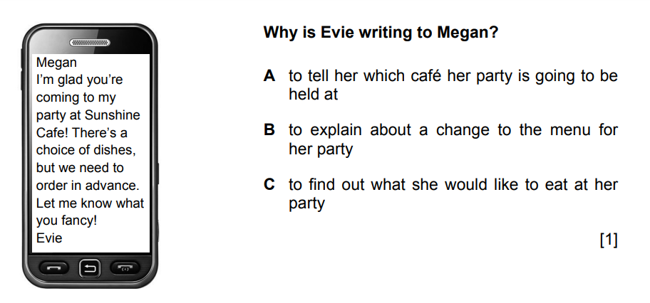
Retrieval Practice
WALT: Understand a range of instructions.

Slide 4
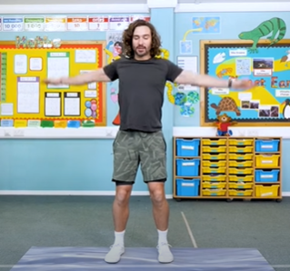
Starter – Listen to the instructions and do the exercises.
WALT: Understand a range of instructions.
https://www.youtube.com/watch?v=vzA8wMx-gew

Slide 5


Listen to the audio.
WALT: Understand a range of instructions.
On your whiteboards write down all the body parts that are mentioned.
Are there any that you don’t know the meaning of?

Slide 6

Listen to the audio again.
WALT: Understand a range of instructions.
Follow along with the exercises.
What exercises would you add to the warm up regime?
How would you instruct others to do it?

Slide 7
WALT: Understand a range of instructions.
With support, I can follow the warm-up instructions.
Independently, I can follow the warm up instructions.
I can suggest exercises to add to a warm up regime.

Slide 8

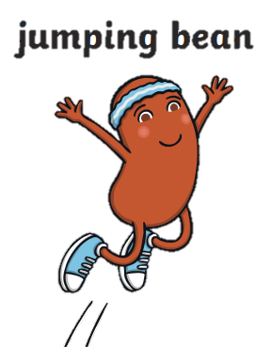

Plenary – Bean Game!
WALT: Understand a range of instructions.

